Slide 1
Predictive analysis model for recommending police workforce
Project Member : Guided By :
19MCA0065 Prashant Dhirendra Prof. Deepa N
19MCA0209 Gourav Joshi
19MCA0002 Vaibhav Bhana

Slide 2
Benchmark Data Set
Data Set contains the following:
Cases Registered under IPC (state and year wise)
Population Census(state and year wise)
Structure of police
State
Year
No of hawaladar, inspector ,DSP etc
Dataset Link
Nature_of_complaints_received_by_police.csv
population.XLS
Police_strength_actual_and_sanctioned.csv

Slide 3
Data Pre-Processing Techniques
Missing Data :
filling global constant, if algorithm work with NULL
otherwise, ignore whole tuple
Data Summaries:
5 point summary of data of
FIR per state
Population of each state

Slide 4
Data Pre-Processing Techniques (cont.)
Normalization
We cannot compare registered cases and structure of polices between state because there might be a significant difference between the population density ( Ex : Haryana and Mizoram )
We can do the following to encounter that : -
Step 1 : FIR per 10,000 person
Step 2 : Convert into ration (Ex. Hawaladar :: Inspector :: DSP)
Now since the scale is different we will use MIN-MAX normalization.

Slide 5
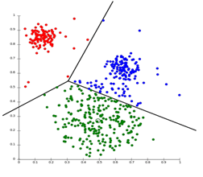
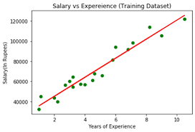
Methodology Used
Finding State with Good Performance
Clustering of State into two category using
K-Means clustering algorithm
Predicting number of FIR
Multiple Linear Regression
Applying BI to find the optimal number of police force required for the predicted number of FIR
Artificial Neural Network

Slide 6
Proposed Frame Work
Raw Data
(population, IPC cases, year, police force structure)
Pre Processing
(Missing data, data summery for outliers and normalization)
Find State with low crime rate
(clustering of state using K-means and data visualization)
Predicting future Crime Rate for each state
(using Linear Regression)
Recommending the police force in future

